Slide 1
Selected Theme
Sustainable AI: Innovate around climate change mitigation, energy efficiency, and sustainability through AI.
Title: "Harnessing Geospatial AI for Wildfire Prediction: A Deep Learning Approach to Mitigate Disaster Risks"
Team 95: Rupasree Dey, Andrei Bachinin, Abdul Matin, Tanjim Faruk
Presenter: Abdul Matin
Department of Computer Science
Notes:
Title

Slide 2
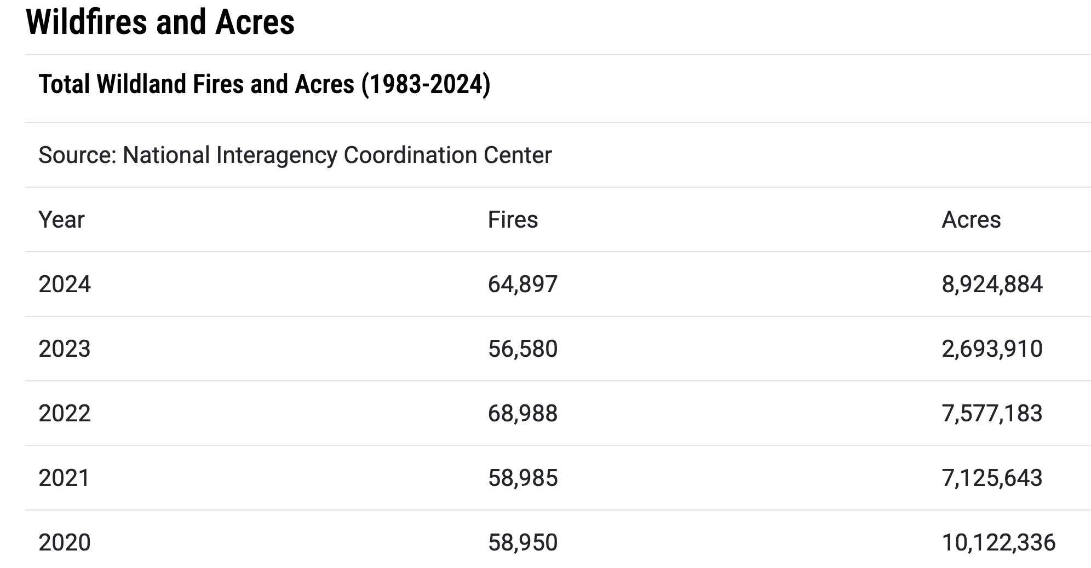
Statistics of Wildfire in USA
Source: https://www.nifc.gov/fire-information/statistics/wildfires

Slide 3
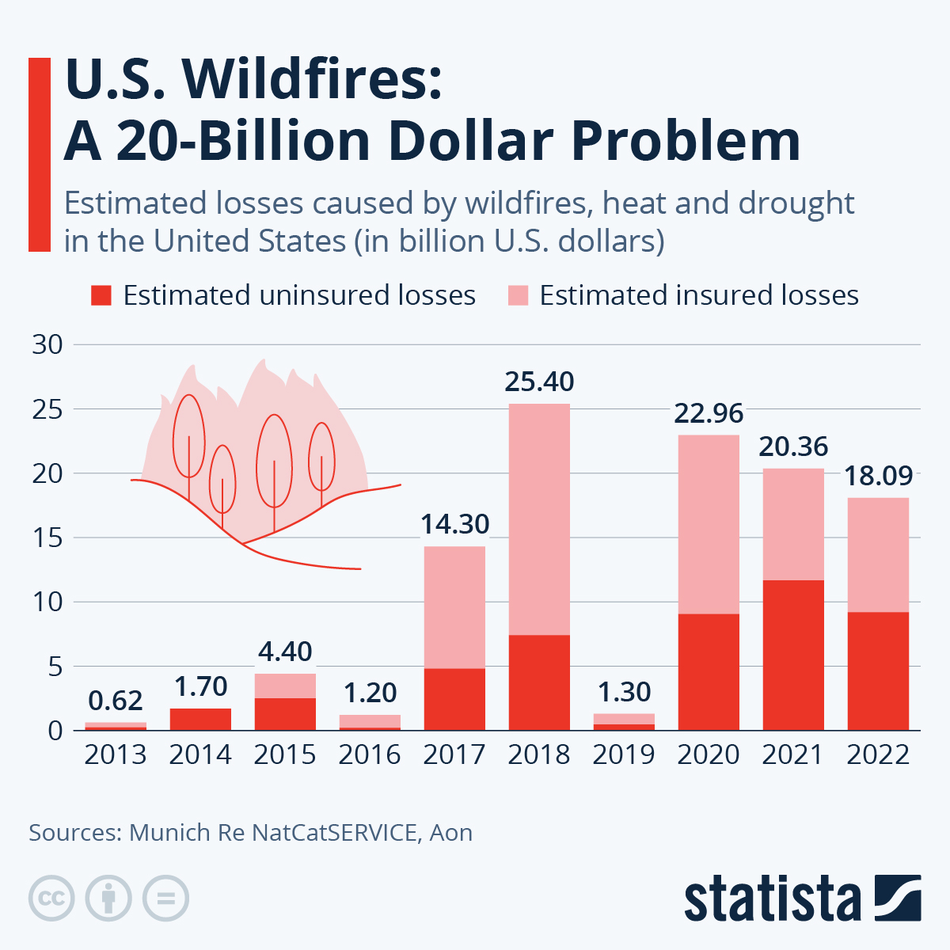
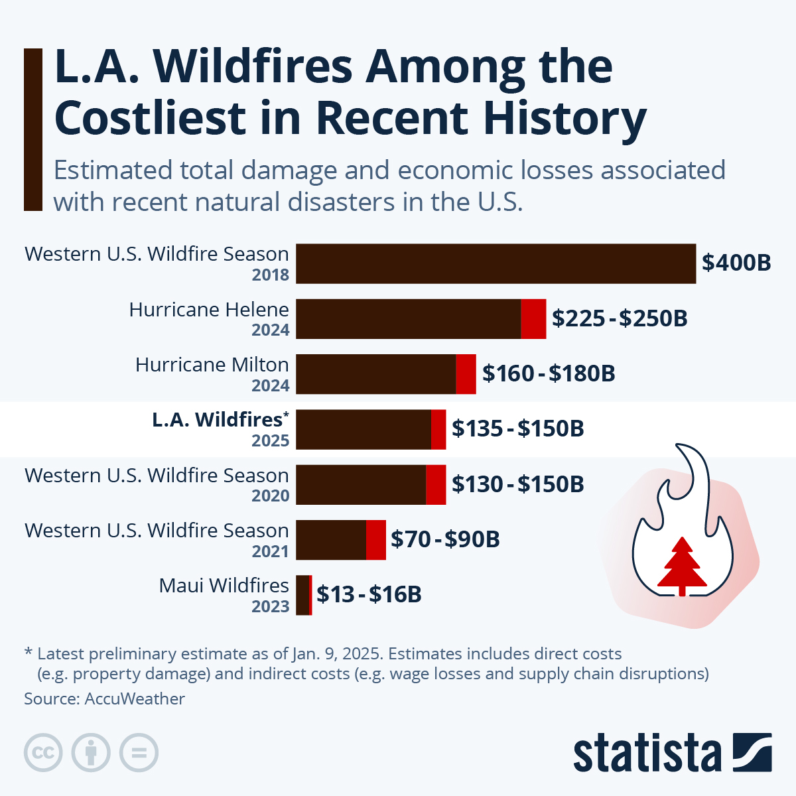

Slide 4
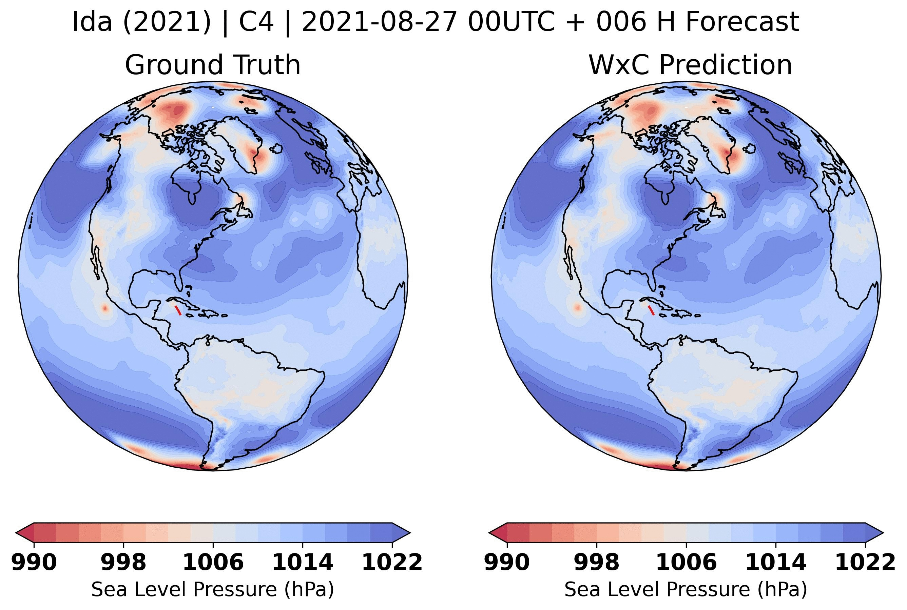
Prithvi WxC | Geospatial Foundational AI Model
Zero shop on Hurricane Ida
Prithvi WxC is a 2.3 billion parameter model
Trained on 160 different variables from MERRA-2 data
Highly accurate atmospheric data prediction

Slide 5
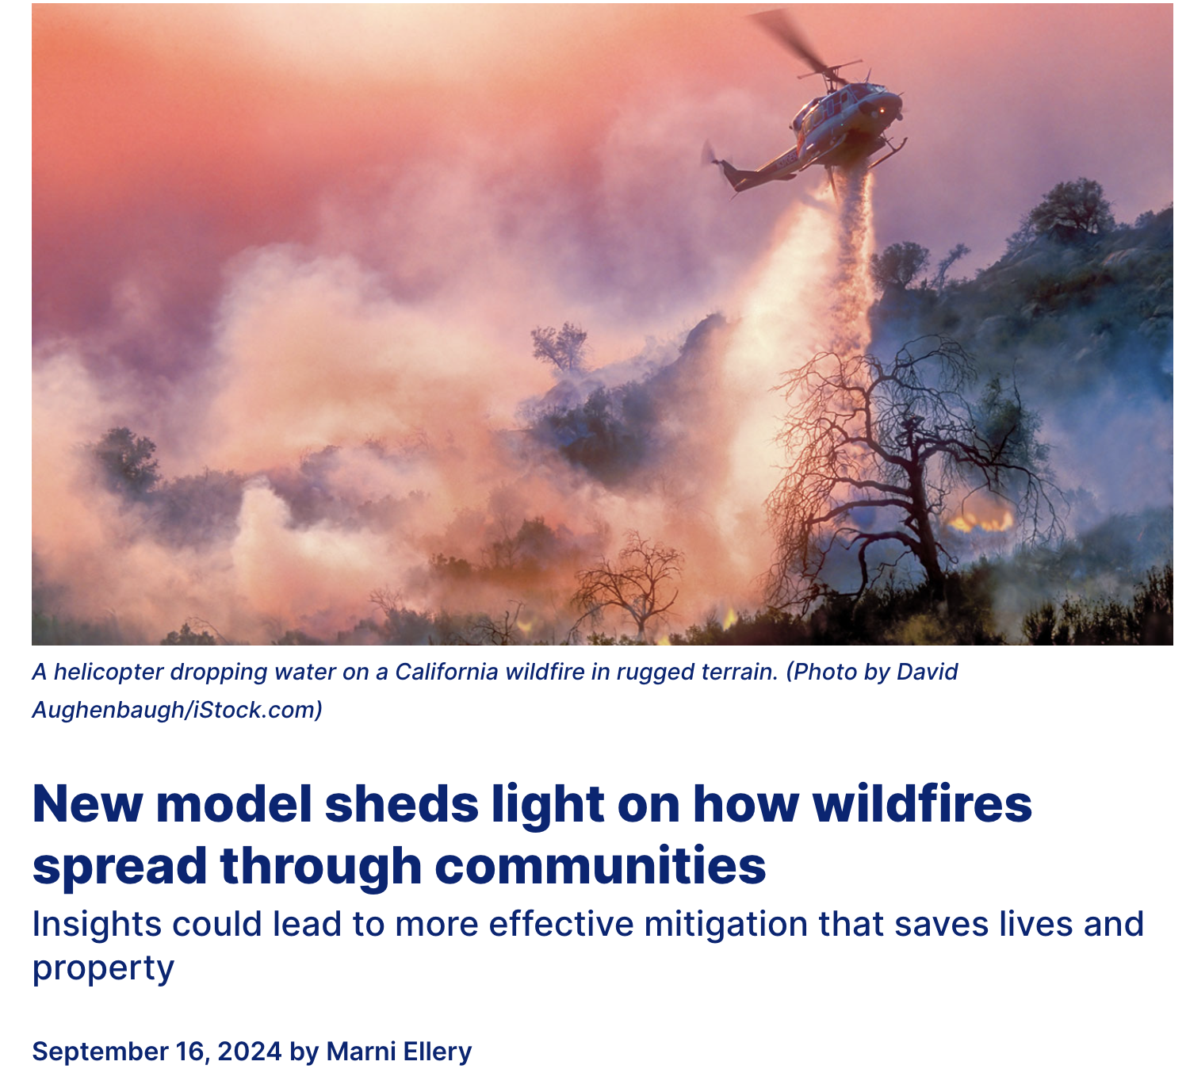
News on September 16, 2024
It indicates the necessity of a sustainable wildfire prediction model
Source: https://engineering.berkeley.edu/news/2024/09/new-model-sheds-light-on-how-wildfires-spread-through-communities/

Slide 6
FireNet | Our proposed Model Architecture
Foundational Geospatial AI model
Encoded Latent Features
MERRA-2
ResNet-UNet
Next Day Fire Mask
Next Day Wildfire Spread Data
Highlight Risky Zone

Slide 7
Dataset and Experiments
Merra-2 for the For Prithvi WxC
Next day fire for ResNet-UNet Model
Input features: ['elevation', 'th', 'sph', 'pr', 'NDVI']
Timeline: 2012-2020
Experiments
Training is going on for Model-2 without Prithvi
Train Samples : 31760
Time: 4-5 hours per epoch
Inference tested for Prithvi WxC with 28G pre-trained model weights
Future Work: Merging the latent features from Prithvi WxC with Next Day fire data

Slide 8
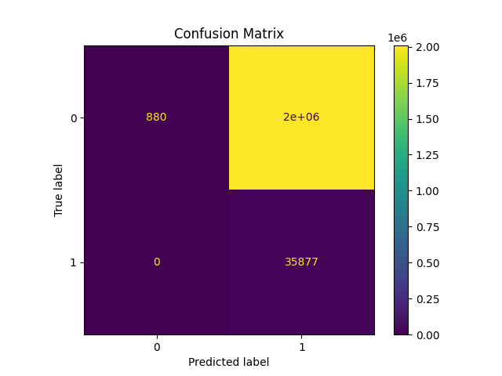
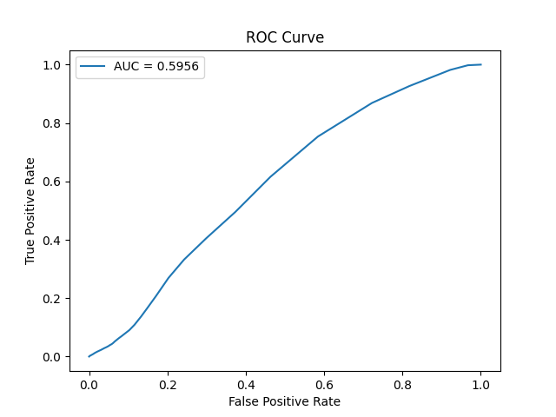
Dataset and Experiments | 10 epochs

Slide 9
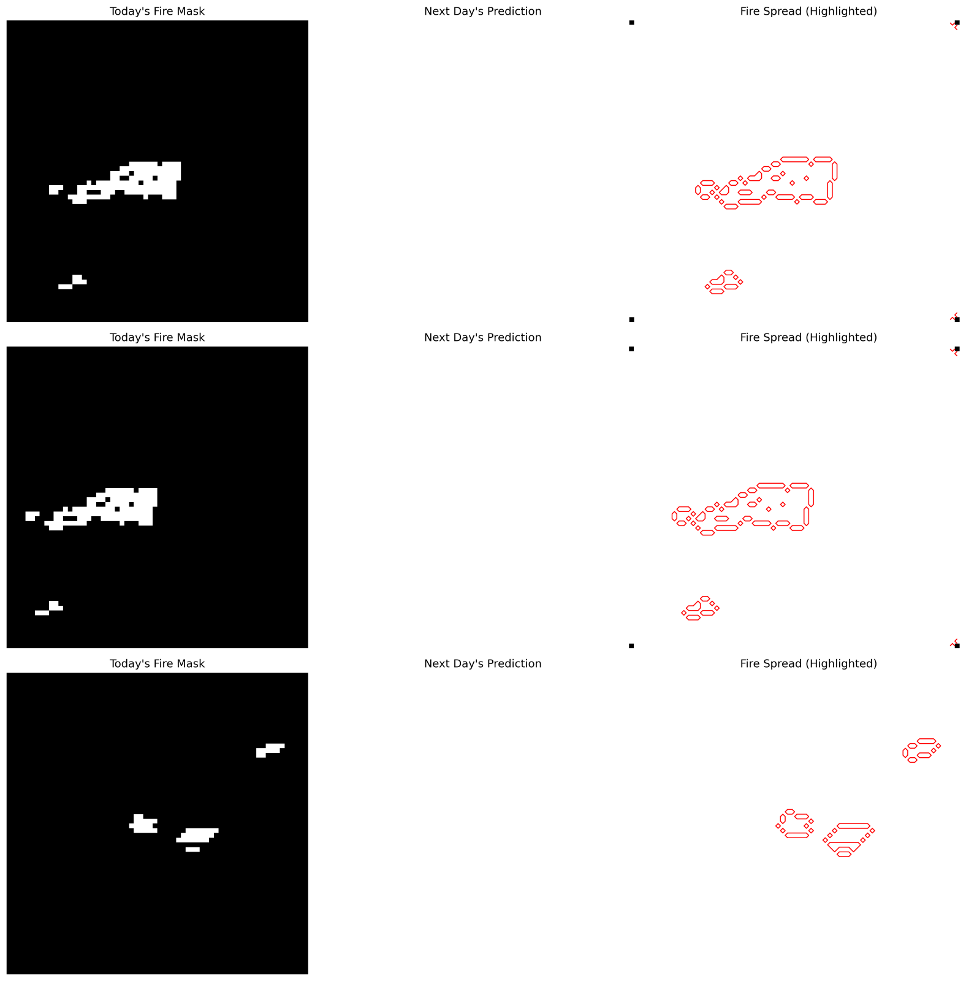
Fire Zone Highlights | 10 epochs
Fire Spread Risk Zone

Slide 10
Thank You

